Slide 1

Texas Housing Market Analysis
Data Analytics & Visualization Project #1
Ali Karimi, Simon Castellanos, Jucary Estrada, Francis Escamilla
June 2021

Slide 2
Description & Scope
The goal of this project is to perform an analysis of the housing market in Texas and evaluate factors that influence the current market trends.
For this project, we gathered housing prices, active inventories, population, prices for oil (WTI), lumber, iron and copper in order to analyze supply and demand for homes and compare the prices against the cost of construction

Slide 3
Questions
What is triggering the rise in housing prices?
What is the relation between population growth and housing inventory?
What is the relation between cost of construction and increase in house prices?
Does oil prices influence demand for homes?

Slide 4
Data Resources
FRED Economic Research (https://fred.stlouisfed.org/).
Population Data by Metropolitan Area
All-Transactions House Price Index for Texas
West Texas Intermediate (WTI), Dollars per Barrel
Producer Price Index Copper Wire and Cable
Producer Price Index Iron and Steel
Producer Price Index Lumber
Zillow Housing Data (Housing Data - Zillow Research)
Median Home Values and number of house listing by Metropolitan Area
A-S

Slide 5
Data Exploration and Clean Up
All team members searched for data in various sites to acquire data for house pricing, inventory and pricing of commodities.
Of all the sources tried and tested, not all produced desired data.
Had issues with finding data sets that could be easily merged with other data sets
A-S

Slide 6
Analysis Process
Used the following Jupyter Notebooks to read the csv files, merge the data sets for the metropolitan areas and create several sets of visualizations.
CommodityAnalysis.ipynb
SC-population.ipynb
A-S

Slide 7
Visualizations and Observations

Slide 8
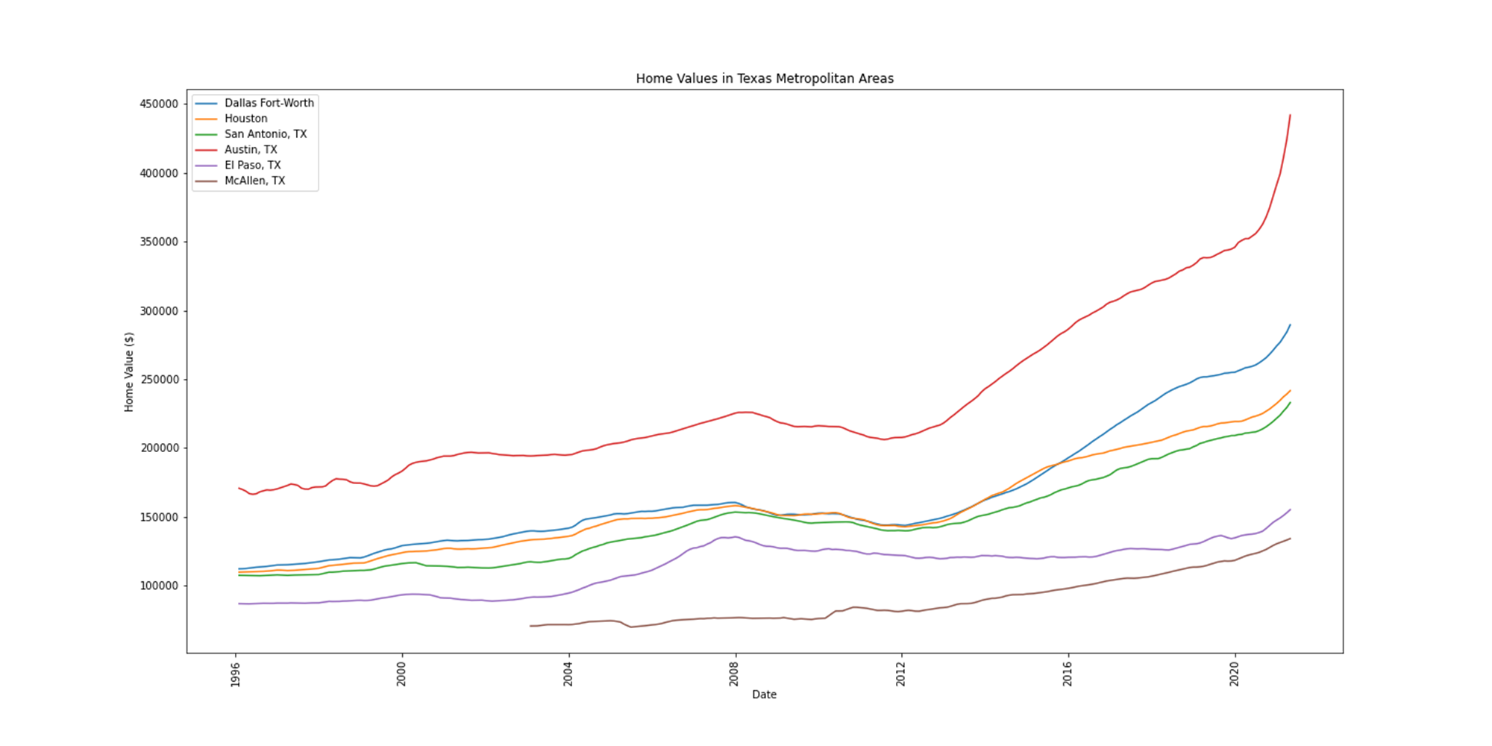
Home Values
Texas metropolitan areas are experiencing an increase in home values.
Austin shows to have higher home values and price increase compared to other metropolitan areas in Texas.
McAllen has the lowest prices and although they are increasing, they seem to be at a steady pace compared to other metropolitan areas.
A-S

Slide 9
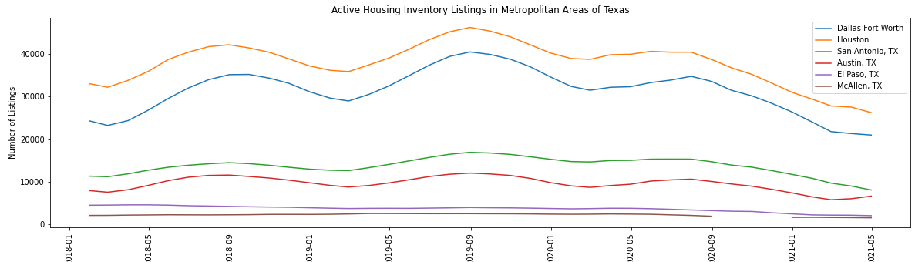
Listing Inventory
Listing inventories reflect a seasonality in home sales.
Inventories for 2020 decreased when compared to the same period for 2018 and 2019
A-S

Slide 10
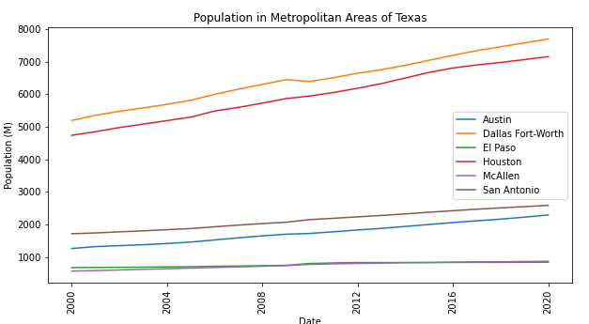
Population Growth
Population grew at a constant rate in all metropolitan areas
A-S

Slide 11
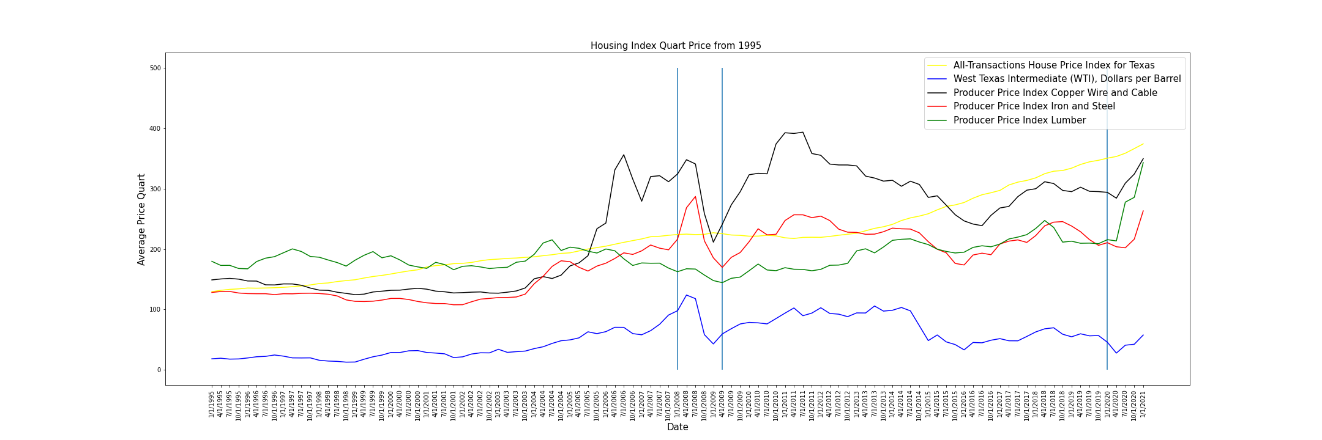
Housing vs. Commodities Index
The housing price changes is not immediate to changes in price fluctuation. In 2008 the housing crisis had minimal effects on the Texas housing market.
In 2014, the rate of change of the House Price Index grew.
A-S

Slide 12
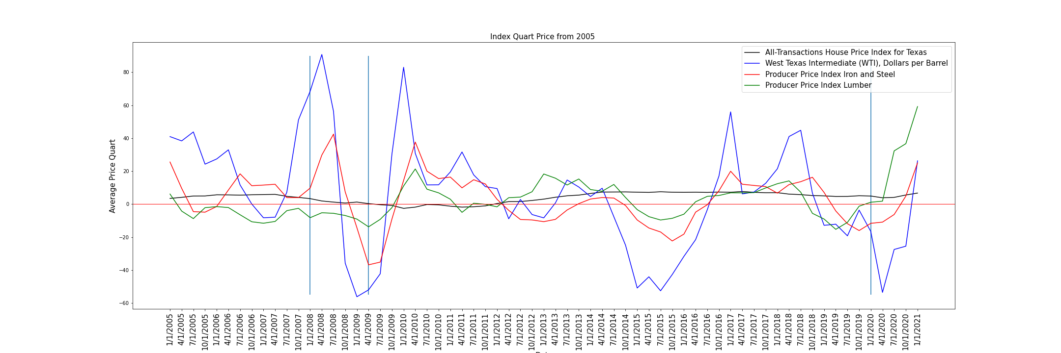
Housing vs. Commodities Percent Change
The housing price changes is not immediate to changes in price fluctuation. In 2008 the housing crisis had minimal effects on the Texas housing market. However, housing pricing did seem to increase as the price of lumber had the most dramatic increase in prices.

Slide 13
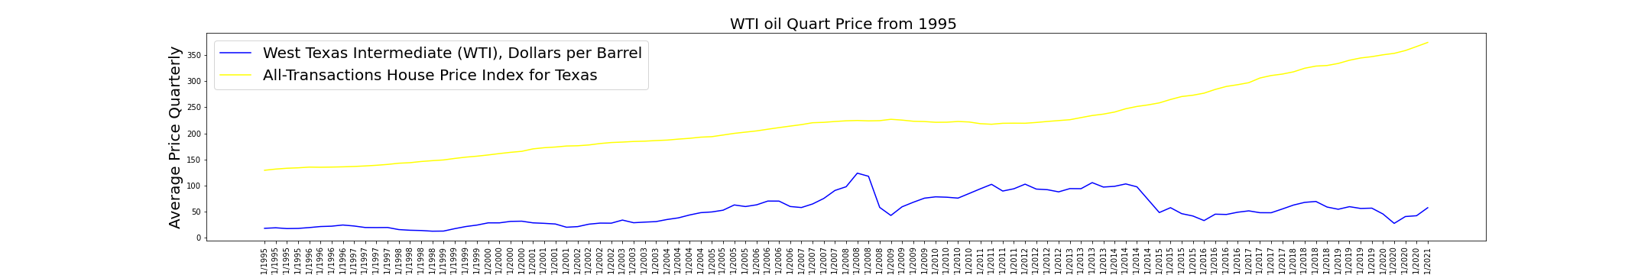
Price Oil Index vs House Price Index
There is no evident relationship between oil prices and the house price index.

Slide 14
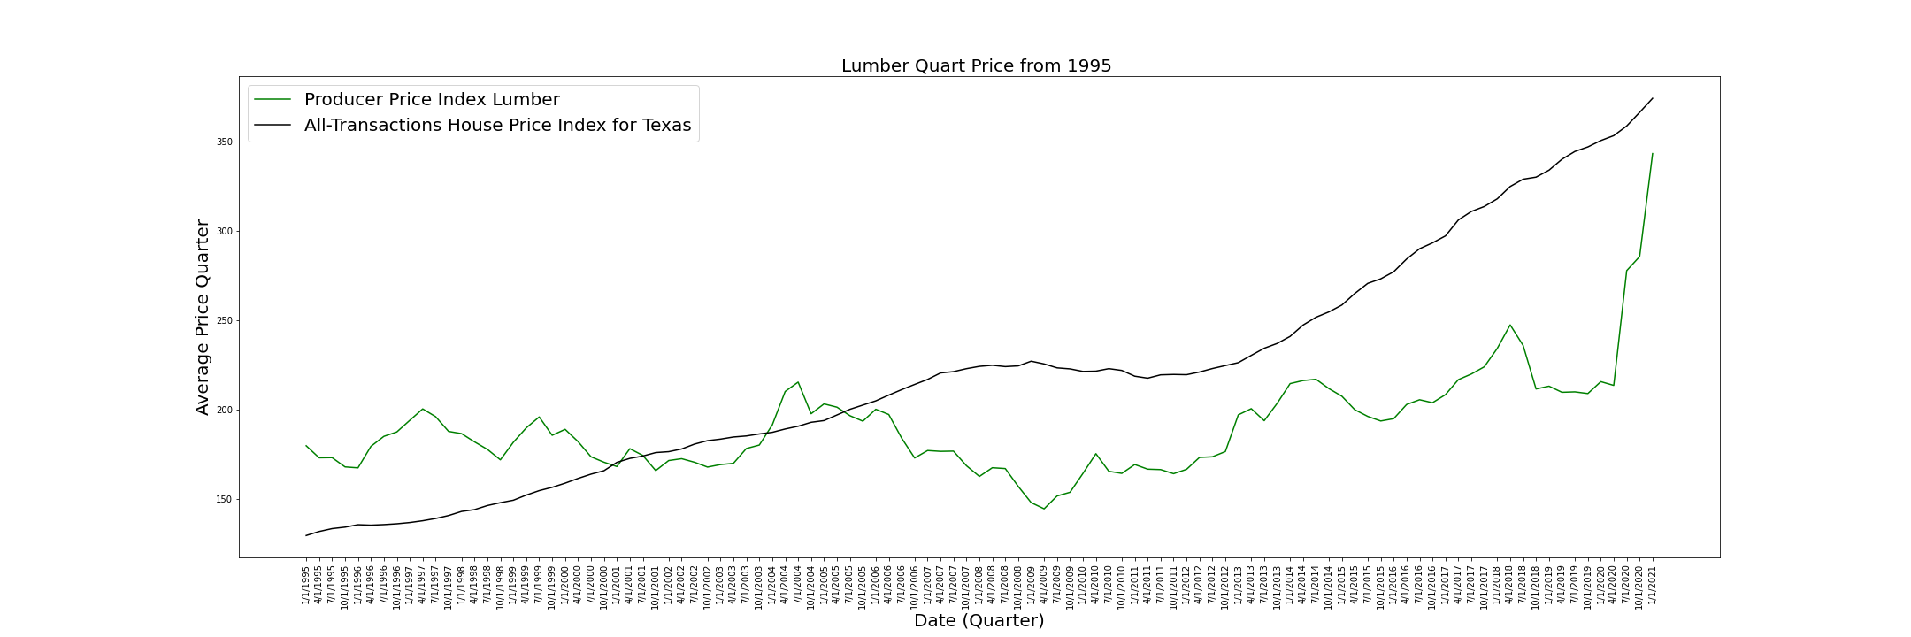
Lumber Price
The demonstration shows a drastic increase in Lumber prices after April 2020.

Slide 15
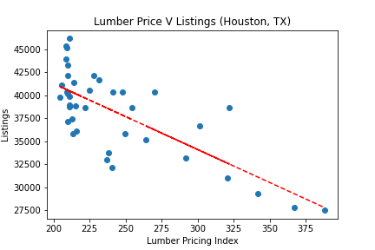
Lumber Price
The graph shows an inverse relationship between the price of lumber and the housing listings

Slide 16
Postmortem
Difficulties:
Housing inventory was only available from 2018-Present.
Most recent census data is from 2020.
We were not able to determine the cause of the increase of lumber prices therefore we will not be able to determine if they would normalize.
If we had more time….
We did not find any data analyzing the housing bubble from 2008 compared to the current trend in housing market.
Is the current trend a housing bubble (overinflation of real state prices)?
Analyze supply and demand based on counties, and other states.
A-S

Slide 17

Questions?

